Slide 1
GTKYH - Easton Park Landscape Architecture
With Chad Kimball of Madrone Landscape Architecture
Chad.is.kimball@gmail.com

Slide 2
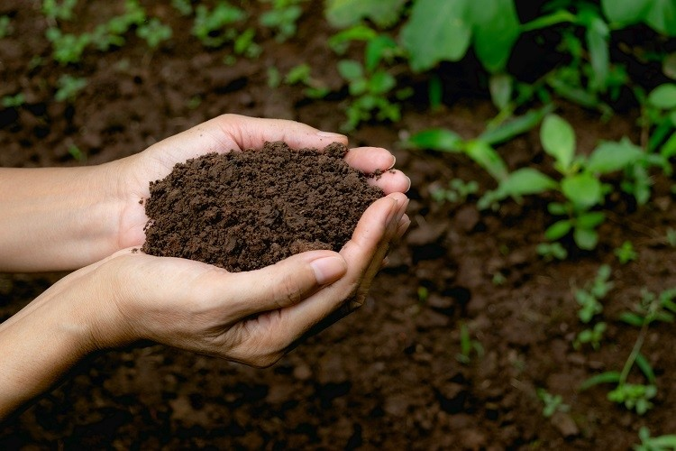
Soil

Slide 3
Soil
Austin soil generally has high alkalinity
  Peat moss, sulphur
In Easton Park we have a lot of clay, which is not necessarily a bad thing
  Add sulphur
  Add granite sand
  Add compost

Slide 4
Soil
When planting a tree, or making a garden bed in Easton Park I like to add topsoil and compost to the clay already in the ground.
Top soil because it has less shrinkage than compost and because its not man made (do your research to find topsoil).
Mix two parts topsoil to one part compost
  Mushroom
  Poultry
  Dairy

Slide 5
Soil
Soil is alive:
  It’s full of microorganisms, mycorrhizae, insects and worms that generally work in symbiosis with plants.
  Keeping the soil healthy by fertilizing, adding compost and mulch will keep your plants healthy.

Slide 6
Soil
Fertilizer:
Microlife:
Acidifier
Bio Matrix
Compost:
Kinser Ranch Mushroom Compost, arguably less nutrients than poultry or dairy, but better for long term soil structure
Soil:
Kinser Ranch Lawn Leveler 50/50 blend of Mushroom Compost and Granite Sand
My favorite products:

Slide 7
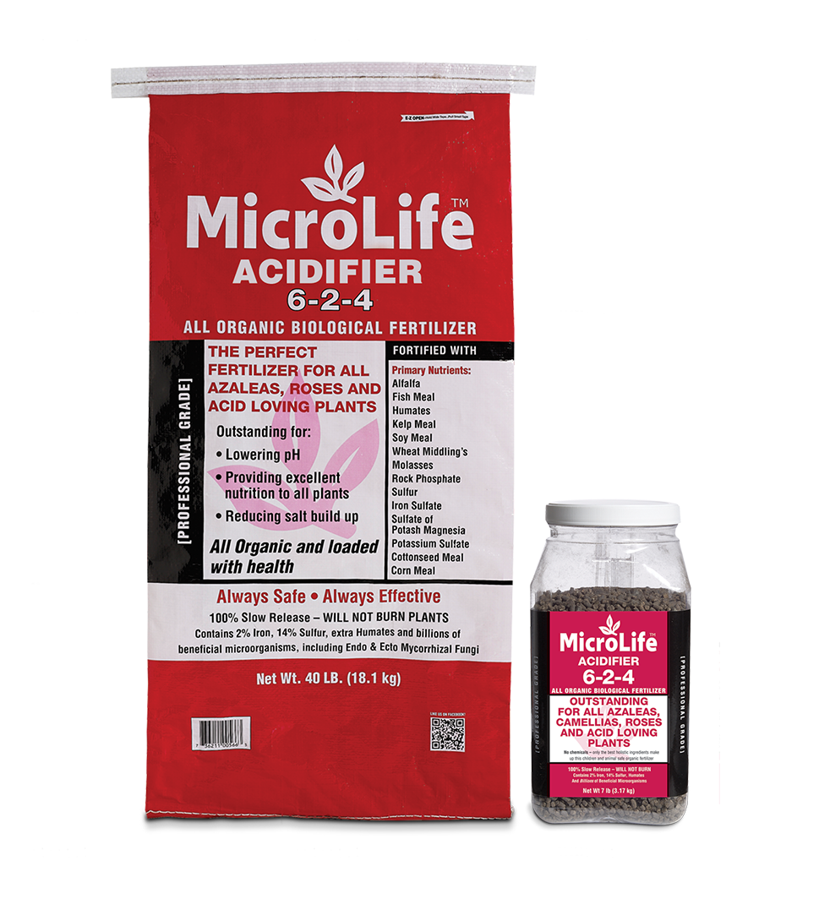
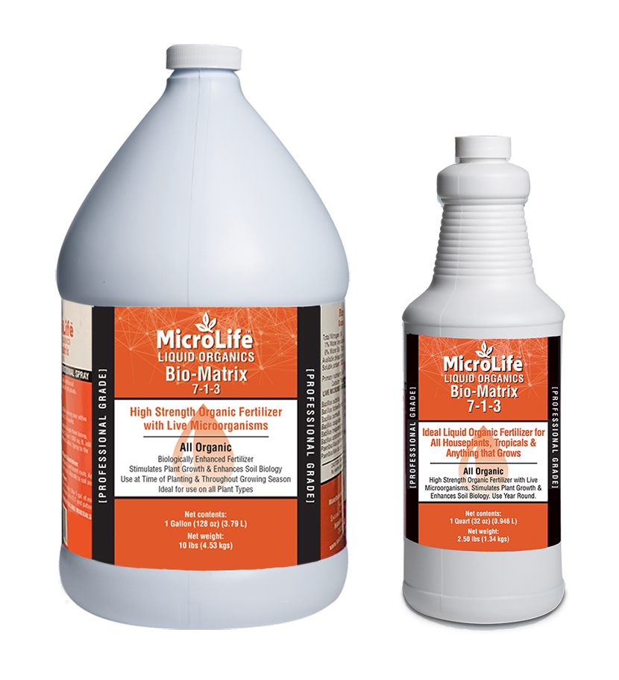
nkknk
Use this slide to show a major stat. It can help enforce the presentation’s main message or argument.

Slide 8
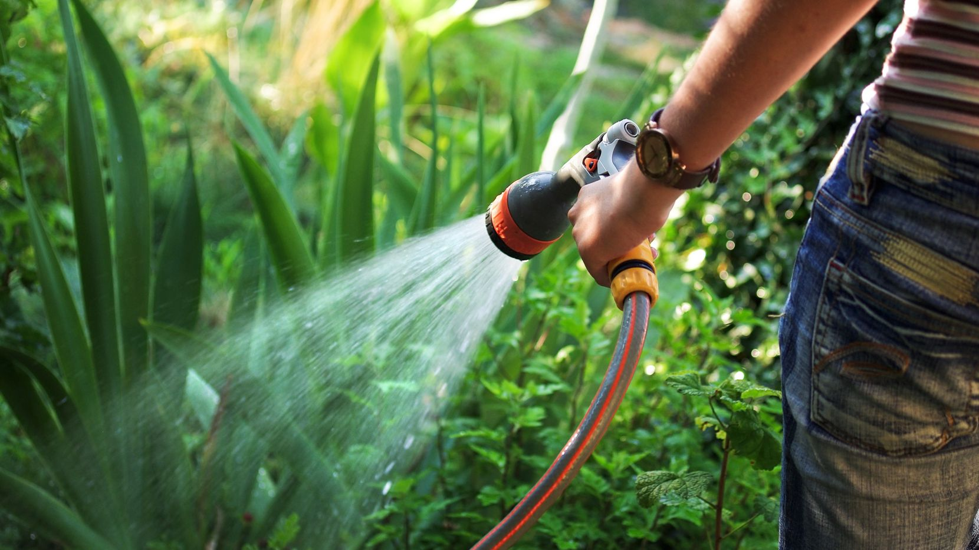
Water
How much?
How Often?

Slide 9
Water
How Much?
Depends on how fast you want your plants to grow, and what types of plants they are.

Slide 10
Water
How Often?
Plants need water when they become droopy
Focus on watering the roots, not the foliage
Give large trees and shrubs a long soak once per week
Keep a healthy layer of mulch on smaller plants

Slide 11
Water
How Often?
Plants will begin to turn yellow when there’s too much water.
Not all plants like a lot of water and will tell you.
Many plants can rot if the stems stay wet.

Slide 12
Water
Don’t be afraid to experiment with watering. Just be sure to monitor the plants and trees closely.
In August - Everything needs water.

Slide 13
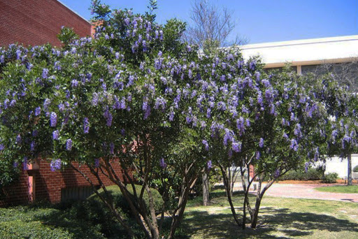
Planting and plants
Keep it simple:
Use evergreen plants
Drought tolerant plants
Proven to thrive in our climate
Texas Mountain Laurel (Sephora Secundiflora)

Slide 14
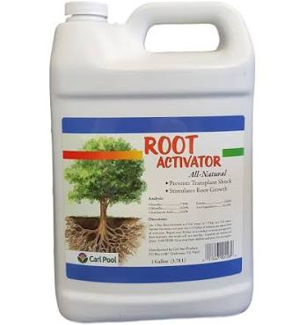
Planting tips
If planting a tree/shrub/small plant in an unprepped location make the hole much wider and deeper than needed.
Plant high
Tickle the roots
Water trees and plants in to remove excess oxygen from soil.
Add fertilizer
Add root stimulator
Mulch and water the mulch

Slide 15
Choosing Plants
Again Keep it simple.
You don’t need variety for variety’s sake.
Group similar water/sun/soil need plants together when possible.
Remember to think in layers. Larger trees and shrubs behind smaller ones.
Think about growth, not just how big a tree or plant is at the moment.

Slide 16
Plants I recommend most often
Some of these may not be in the approved plants list. Seek permission before planting.
Trees:
Live Oak
Bur Oak
Monterey White Oak
Magnolia
Holly (Eagleston, Nellie R Stevens)
Chinese Fringe Tree
Redbud (Texas, Forest Pansy)
Shrubs:
Texas Mountain Laurel
Eve’s Necklace
Yaupon Holly
Possum Haw

Slide 17
Plants I recommend most often
Some of these may not be in the approved plants list. Seek permission before planting.
Plants:
Lespedeza (little volcano)
Dwarf Olive (little ollie)
Viburnum (awabuki, sandankwa)
Salvia (Amistad, Henry Duelberg)
Roses (Ducher, Belinda’s blush)
Lantana (all types)
Kidneywood
Rosemary (Huntington carpet)
Gregg’s blue mist flower
Basil (all types)
Sage (all types)
Ground covers:
Creeping thyme
Silver pony foot

Slide 18
Plants I recommend most often
Some of these may not be in the approved plants list. Seek permission before planting.
Grasses:
Gulf coast muhly
Seep muhly
Blue gramma (blonde ambition)
Side oats gramma
Miscanthus (adagio grass)
Berkeley sedge
Agave:
Whales Tongue
Parryi truncata
Blue glow
Yucca:
Rustrata
Red yucca
Giant hesperaloe

Slide 19
Plants I recommend most often
Some of these may not be in the approved plants list. Seek permission before planting.
Vines:
Star Jasmine
Wisteria
Evergreen clematis
Fig ivy

Slide 20
Thank you!
Any Questions?
Chad Kimball
chad.is.kimball@gmail.com

